Slide 1
compete
empower
expand

Slide 2
How to compete and win in the BI space
TECH-BAAI200
Colin Murphy, Tobias Böhmerle, Olivier Matrat
#TECH-BAAI200

Slide 3
Confidentiality slide

Slide 4
Session objectives and takeaways
At the end of this session, you should be better able to…
Find & know how to use BI compete material
How to land and expand with Power BI
Know where to go to learn & ramp on BI to better support your customers

Slide 5







Update on the BI landscape
3/16: Google Analytics 360 Suite announced, Data Studio 360 one of four new core products
09/16: Google Data Studio available in 22 countries
2/17: Free unlimited Data Studio Reports for all users
3/17: Free version of Data Studio rolled out globally
8/16: Adam Selipsky new CEO
11/16: 3-year roadmap presented in TC16
11/16: Tableau goes with AWS for US East Coast expansion
4/17: Subscription pricing released publicly
5/17: Tableau 10.3 released
2/16: Thoma Bravo announces Qlik’s acquisition (completed 8/16)
5/16: QlikSense Enterprise 3.0 and QlikSense Cloud Business offer announced
2/17: Named a Leader by Gartner, but loses ground on Microsoft and Tableau
10/16: Desktop product is now free
3/17: v10.7 launched
09/16: Wave Marketing and IT apps available
10/16: Einstein AI is key theme at Dreamforce
10/15: QuickSight announced at re:Invent
11/16: Standard Edition GA
11/16: Integration between Athena and QuickSight, announced at re:Invent
12/16: Enterprise Edition GA in US East
4/17: Feature updates announced, such as CSV export
05/16: Cloud for Analytics becomes Business Objects Cloud; Lumira becomes Business Objects Lumira
10/16: Lumira 1.31 is released

Slide 6
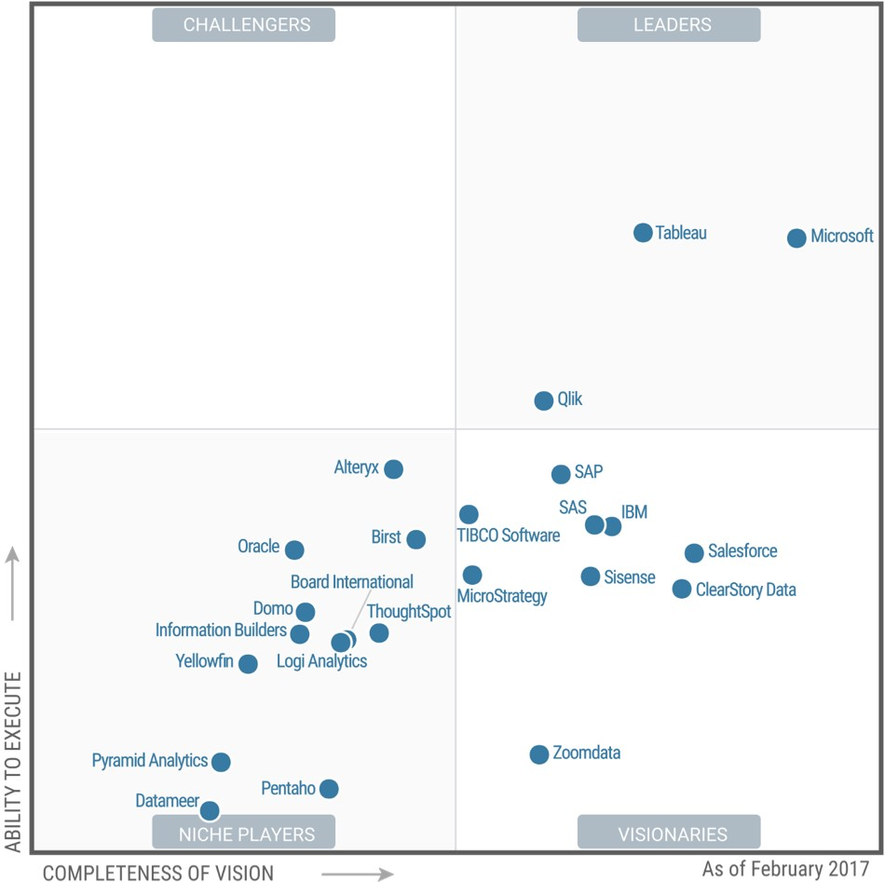

Microsoft is Positioned as a Leader for the tenth consecutive year in the Gartner Magic Quadrant for Business Intelligence and Analytics Platforms
FEBRUARY 2017
A Leader in the Magic Quadrant for BI & Analytics*
*Gartner “Magic Quadrant for Business Intelligence and Analytics Platforms,” by Rita L. Sallam, Cindi Howson, Carlie J. Idoine, Thomas W. Oestreich, James Laurence Richardson, and Joao Tapadinhas February 16, 2017
This graphic was published by Gartner, Inc. as part of a larger research document and should be evaluated in the context of the entire document. The Gartner document is available upon request from Microsoft. Gartner does not endorse any vendor, product or service depicted in its research publications, and does not advise technology users to select only those vendors with the highest ratings or other designation. Gartner research publications consist of the opinions of Gartner's research organization and should not be construed as statements of fact. Gartner disclaims all warranties, expressed or implied, with respect to this research, including any warranties of merchantability or fitness for a particular purpose.

Slide 7
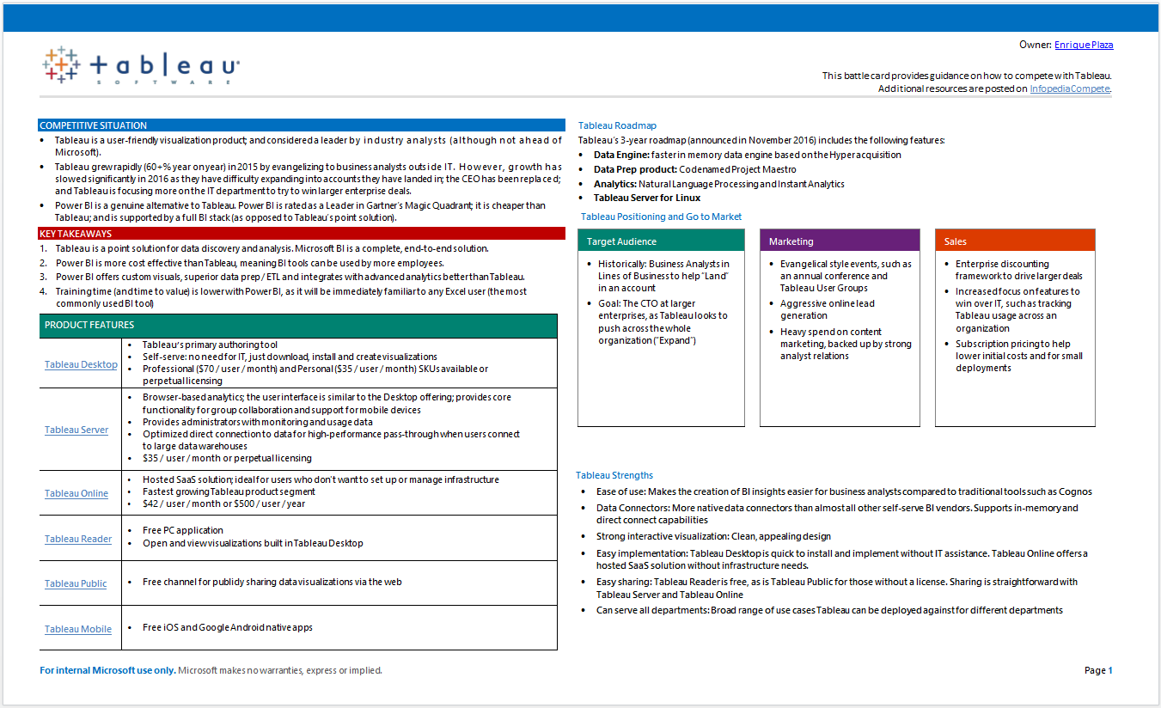
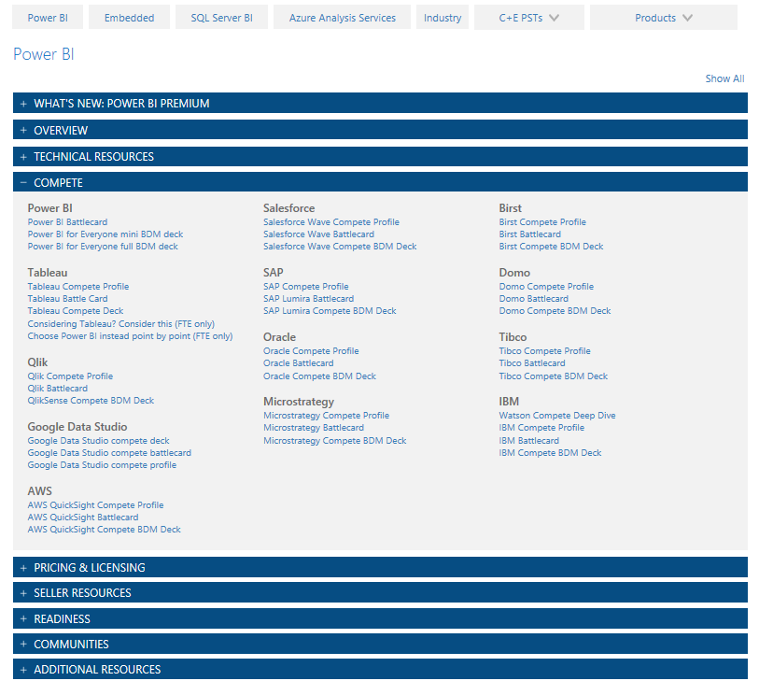
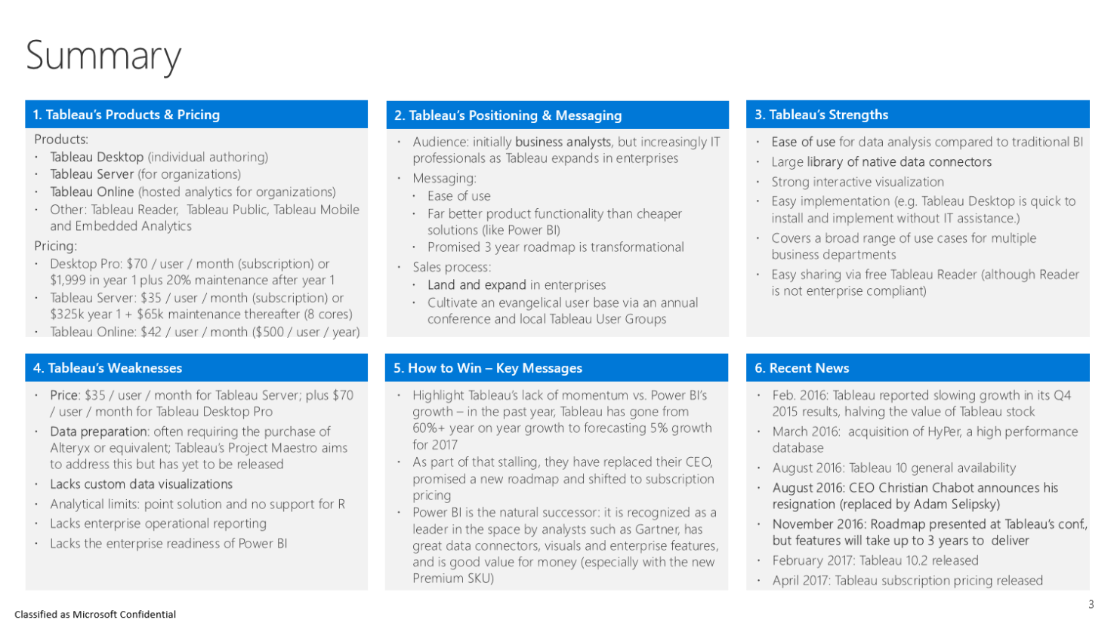
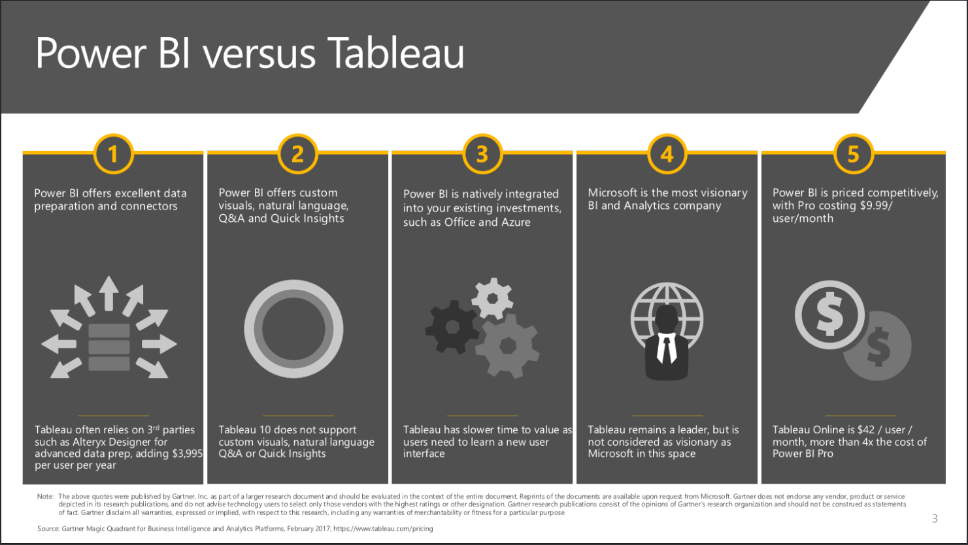
Where to find compete material
http://aka.ms/bi
Battle Card
Compete Profile
Compete Deck

Slide 8

Power BI versus Tableau
1
2
3
4
5
Power BI offers excellent data preparation and connectors
Power BI offers custom visuals, natural language, Q&A and Quick Insights
Power BI is natively integrated into your existing investments, such as Office and Azure
Microsoft is the most visionary BI and Analytics company
Power BI is priced competitively, with Pro costing $9.99/ user/month
Tableau often relies on 3rd parties such as Alteryx Designer for advanced data prep, adding $3,995 per user per year
Tableau 10 does not support custom visuals, natural language Q&A or Quick Insights
Tableau has slower time to value as users need to learn a new user interface
Tableau remains a leader, but is not considered as visionary as Microsoft in this space
Tableau Online is $42 / user / month, more than 4x the cost of Power BI Pro
Note: The above quotes were published by Gartner, Inc. as part of a larger research document and should be evaluated in the context of the entire document. Reprints of the documents are available upon request from Microsoft. Gartner does not endorse any vendor, product or service depicted in its research publications, and do not advise technology users to select only those vendors with the highest ratings or other designation. Gartner research publications consist of the opinions of Gartner’s research organization and should not be construed as statements of fact. Gartner disclaim all warranties, expressed or implied, with respect to this research, including any warranties of merchantability or fitness for a particular purpose
Source: Gartner Magic Quadrant for Business Intelligence and Analytics Platforms, February 2017; https://www.tableau.com/pricing

Slide 9




























Power BI offers strong data prep and a broad range of data connectors to accelerate time to value
Power BI
Superior data preparation capabilities for free through Power BI Desktop
Power BI connects to hundreds of data sources: Excel spreadsheets, on-premises, cloud services, big data and streaming data
ODBC and Odata support to ensure the broadest possible connectivity
Selected data sources supported by Power BI
Tableau
Tableau currently fills its data prep gap by recommending third-party tools (e.g., Alteryx)
Project Maestro, Tableau’s data prep project, is only a roadmap commitment right now
Tableau Online supports connectivity to fewer cloud sources than Power BI
Dynamics Marketing
Azure Audit
Logs
Microsoft Dynamics NAV
Azure Mobile
Engagement
Application
Insights
SQL Database
Auditing

Slide 10
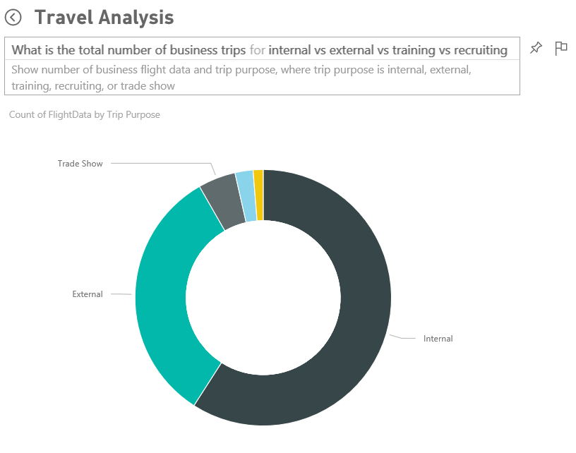
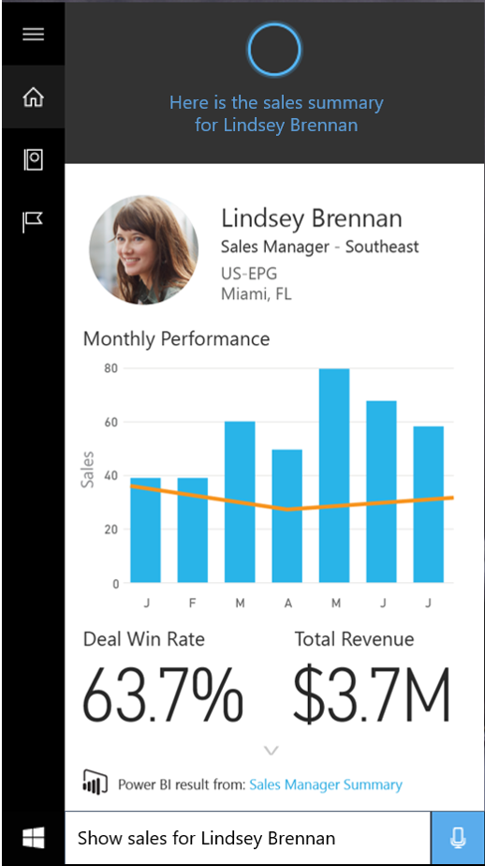
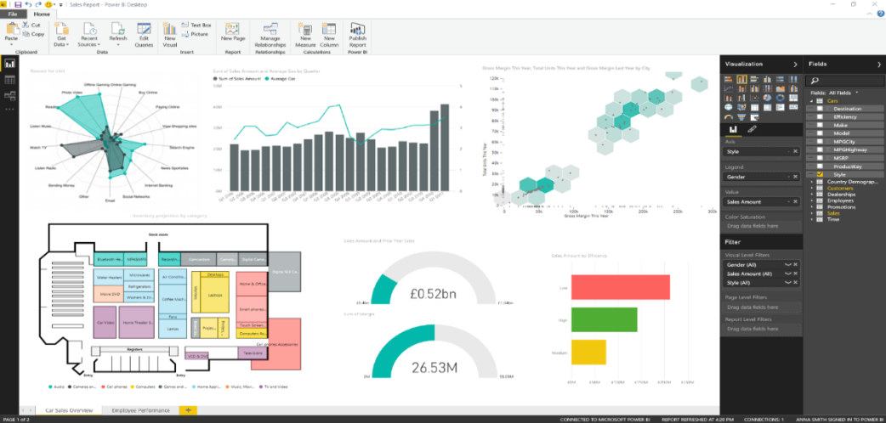
Power BI supports custom visuals, natural language Q&A and Quick Insights
Power BI
Custom visuals broaden the range of visualizations possible
Natural language Q&A : get answers from your data by asking questions in natural language
Quick Insights: auto search datasets in seconds
Cortana integration: access your data from Windows 10
Tableau
Lacks custom visuals; users are limited to creating visuals pre-prescribed by Tableau
Natural Language and Quick Insights equivalent have just been announced as roadmap items
Tableau 10 was only an incremental improvement, focused on a new color palette and font
“Hey Cortana, show sales for Lindsey Brennan”
10

Slide 11
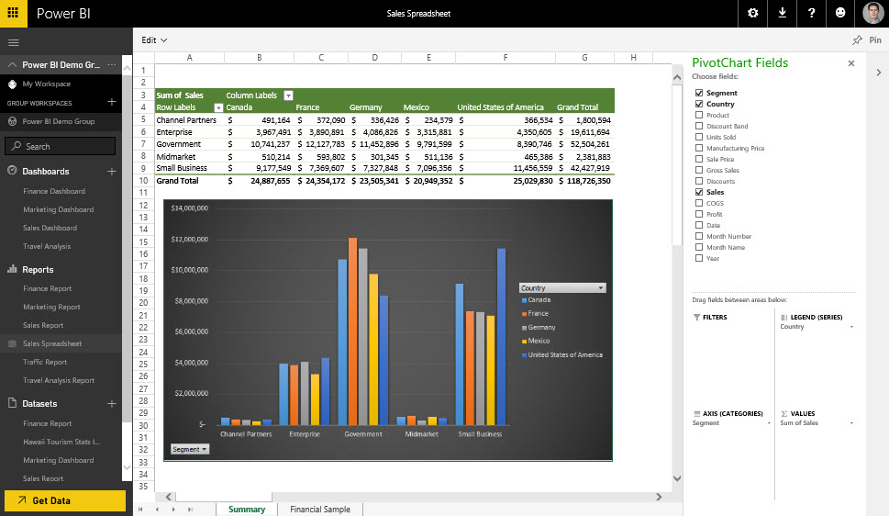
Power BI is natively integrated into Office and Azure
Power BI
Use Excel data and pin live charts to your Power BI dashboards
Share spreadsheets to Power BI and view them through Excel Online
Collaborate via Office 365 groups
Analyze directly in Excel, including PivotTables
Natively integrated into Azure to ease data connectivity and storage
Tableau
Does not have a “build once, use anywhere” approach to modeling that Microsoft has
Less integration with everyday desktop tools, like Office – ultimately slowing task times
Slower time to value as any new users will need to become familiar with Tableau

Slide 12
Insight for everyone with Power BI
Tableau | Price (user/month) | Power BI | Price
Tableau Desktop Personal | $35 | Power BI Desktop | Free
Tableau Desktop Professional | $70
Tableau Online | $42 | Power BI Pro | $9.99 (user/month)
Tableau Server | $35 | Power BI Premium* | See calculator
Source: https://www.tableau.com/pricing
*Power BI Premium includes access to Power BI Report Server for on premises deployment

Slide 13
Demo
Colin

Slide 14
Customer wins
Tobias

Slide 15
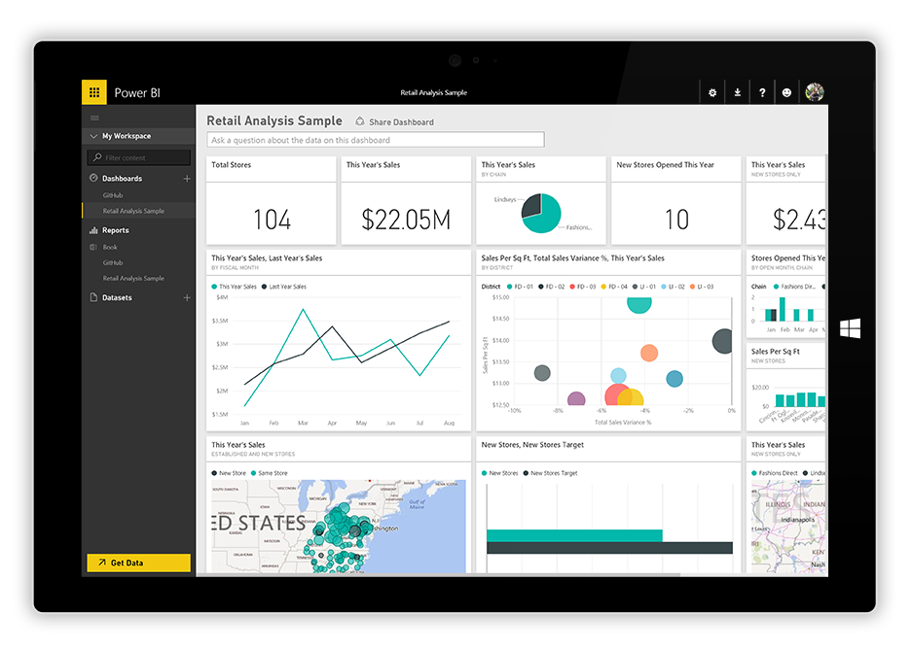

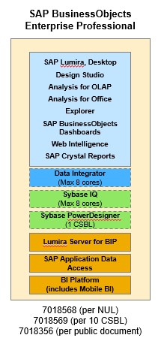








Power BI and the market
Power BI
Lumira
BI Suite
BO Cloud
Tableau
Others
Excel

Slide 16

Henkel – Office365 E5
5000 stepup from Office365 E4 to E5 Suite
driven by Power BI and PSTN conferencing
Power BI as the strategic self service tool
Competing against Tableau, Qlik and SAP BO
Continue to grow with Power BI Premium

Slide 17




most likely future wins and why the will decide for Power BI

Slide 18
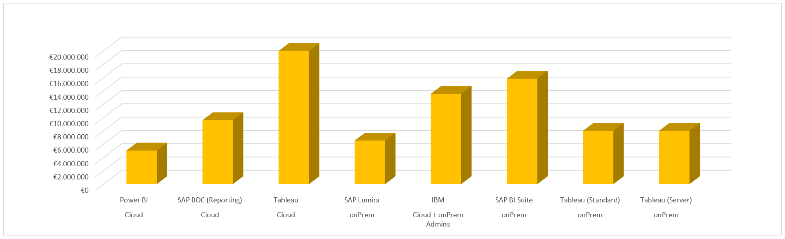
If all arguments doesn´t work out – we win because of the price
10.000 user over 5 years
1. Power BI list price
2. Assumed competitors discounts: 20% for Cloud and 60% for on-premises

Slide 19
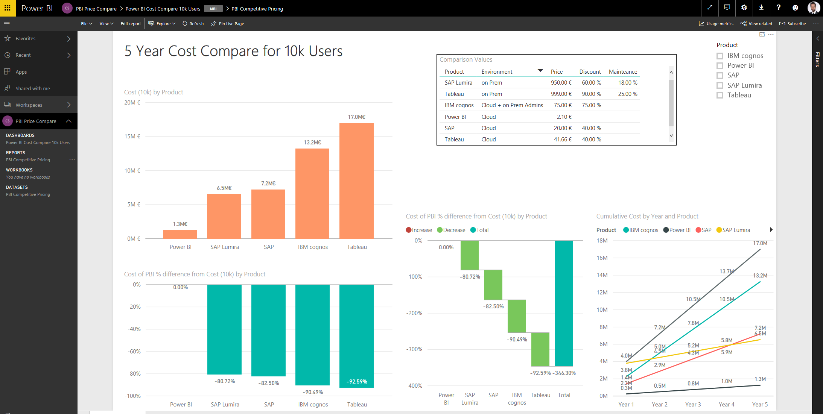
Pricing – a deeper look

Slide 20
Power BI Customer Advisory Team (C.A.T.) Olivier Matrat olmatrat@Microsoft.com

Slide 21

Power BI Customer Advisory Team (CAT)
GET the CATBot!
BDM Showcase
Patterns & Practices
We curate content on cross-cutting technology topics
Sales Community Support
We support technical escalations & training opportunities
Engineering Feedback
We influence the products roadmap through engineering feedback rhythms
We own demo resources for CxO-level conversations
Engage strategic Power BI customers
and the sales professionals supporting them
to showcase and provide technical
guidance, help drive product adoption and
consumption and influence our engineering
roadmap.
“
”
Join the conversation on PBICAT @ Teams

Slide 22
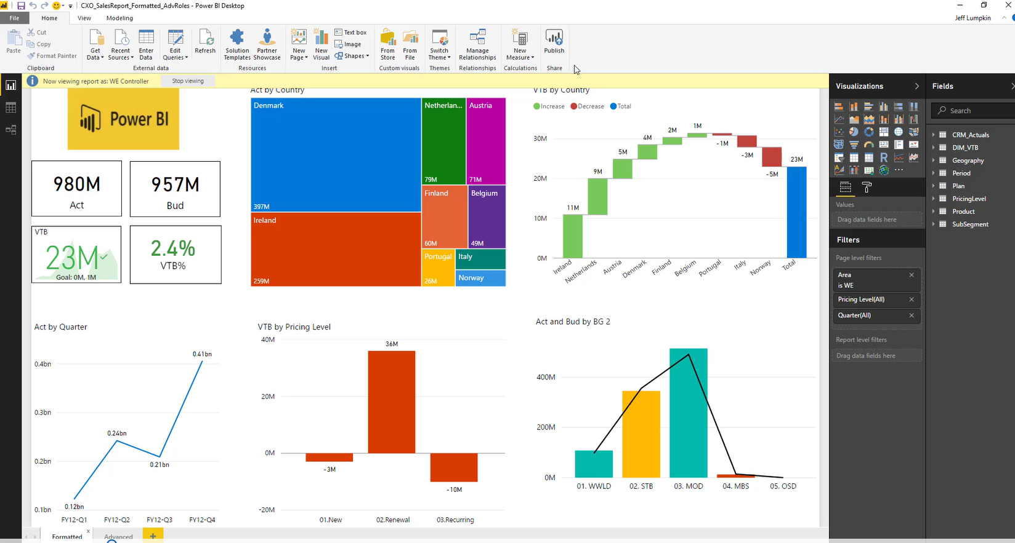
Power BI CAT Team | BDM Showcase
Create Roles for RLS
Publish a Power BI Desktop File
Create a Dashboard
Advanced Functionality
Q&A
Quick Insights
Analyze in Excel
Web view and phone view
Sharing options
https://teams.microsoft.com/_#/conversations/2.%20BDM%20Showcase?threadId=19:942d1eb5ffb44695af3b052013c54e48@thread.skype&ctx=channel

Slide 23
Summary

Slide 24
Internal resources
Power BI | General info
Compete, Decks, Papers, FAQ’s, Demos & more
https://aka.ms/bi
Internal BI community
BIChamps@Microsoft.com
Power BI CAT Team
Join the conversation on the PBICAT Teams
https://aka.ms/pbicat
Learn the BDM Showcase Demo
https://teams.microsoft.com/_#/conversations/2.%20BDM%20Showcase?threadId=19:942d1eb5ffb44695af3b052013c54e48@thread.skype&ctx=channel
Get the CATBot Power App
https://aka.ms/pbicatbot

Slide 25
External resources
Contact Support
Report Errors, Issues – Support.PowerBI.com (Must have a Power BI Pro license)
Resources
Community.PowerBI.com – Community Forum
Report Theme Gallery – A showcase for stunning report themes
Data Stories Gallery – Get inspired with Data Stories by other Power BI users
R-Visuals Gallery – Get inspired by others use of R for analyzing their data
Visuals.PowerBI.com – Custom PBI visuals and R visuals you can download and use in your story
Power BI Blog - weekly updates
User Voice for Power BI – Vote on (or submit) your favorite new ideas for Power BI
Issues.PowerBI.Com – log issues with the community
Whitepaper - Creating an Enterprise Class Dashboard Solution with Power BI
Guided Learning Self Service Power BI training
DAX Formula Language – syntax for DAX
DAX Patterns – Great website to learn new patterns for the DAX Language
Power Query Formula Language – syntax for the “Query” language

Slide 26
Q&A
If you have questions please proceed to the Q&A MICROPHONE located in your session room.

Slide 27

Enjoy a session
Fill out an eval
Win a prize
Make MS Ready better
Evaluations can be submitted via
Laptop/Mobile connect to Schedule Builder on www.microsoftready.com
Windows/Windows Phone MS Ready App (Search “MS Ready” in the Store)
Your Mobile Device scan the QR code to reach your evals
*If you plan to remain in this room for the next session, please be sure to scan your badge again at the door prior to the session starting

